Slide 1
Welcome!
Sunday
Worship 9:30 AM
Sunday
Bible Class (Livestream) 5:00 PM
Wednesday
Bible Class (Livestream) 7:00 PM
www.SunsetchurchofChrist.net

Slide 2
Order of Service
Opening Prayer | Ryan Sollars
Song 180 | Chris Willis
Lord’s Supper | Craig Foster
Song 439 | Chris Willis
Lesson | Brian Haines
Song 324 | Chris Willis

Slide 3
Senseless Idols

Slide 4
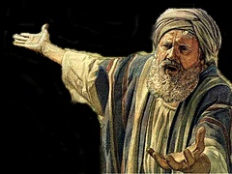
Isaiah’s Plea
Isaiah 44:10-20
Idolaters destroys themselves
Idolaters makes the idol of themselves
Senseless nature of creating an idol

Slide 5
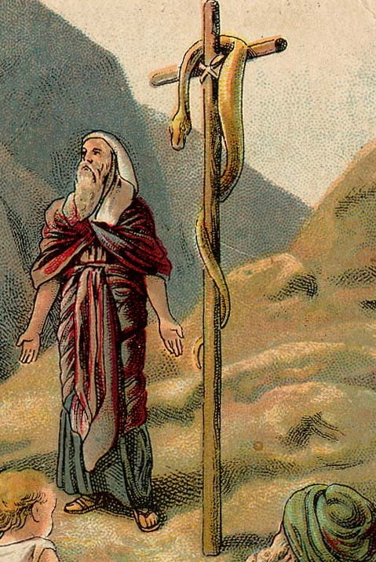
Idolatry in Isaiah’s Time
The worship of Nehustan
Numbers 21:9
Notes:
Nu 21:9 So Moses made a bronze serpent, and put it on a pole; and so it was, if a serpent had bitten anyone, when he looked at the bronze serpent, he lived.
2Ki 18:4 He removed the high places and broke the sacred pillars, cut down the wooden image and broke in pieces the bronze serpent that Moses had made; for until those days the children of Israel burned incense to it, and called it Nehushtan.

Slide 6
Idolatry in Isaiah’s Time
The worship of Nehustan
Numbers 21:9
2 Kings 18:4
Possibly representing God
Most OT idolatry was of God!
Notes:
Nu 21:9 So Moses made a bronze serpent, and put it on a pole; and so it was, if a serpent had bitten anyone, when he looked at the bronze serpent, he lived.
2Ki 18:4 He removed the high places and broke the sacred pillars, cut down the wooden image and broke in pieces the bronze serpent that Moses had made; for until those days the children of Israel burned incense to it, and called it Nehushtan.

Slide 7
Idolatry in Our Time
1 Corinthians 10:12-22
- An idol is “nothing” (1 Cor. 8:4)
- Behind idols are demons
- “flee from idolatry”
Notes:
1Co 8:4 ¶ Therefore concerning the eating of things offered to idols, we know that an idol is nothing in the world, and that there is no other God but one

Slide 8
Idolatry in Our Time
1 Corinthians 10:12-22
Colossians 3:5/ Ephesians 5:5
- Idolatry is a spiritual condition
- Desiring things (before God)
Notes:
Col 3:5 Therefore put to death your members which are on the earth: fornication, uncleanness, passion, evil desire, and covetousness, which is idolatry.
Eph 5:5 For this you know, that no fornicator, unclean person, nor covetous man, who is an idolater, has any inheritance in the kingdom of Christ and God.

Slide 9
Idolatry in Our Time
The idols of our day
- Those things that we place before God
Work, family, home, recreation
- Those things that we give undue attention
Even things given by God
Spiritual traditions

Slide 10
Idolatry in Our Time
Idolaters destroys themselves
Putting anything before God is self destructive
Wasting our time on vain things
Destroying our relationship with God

Slide 11
Idolatry in Our Time
Idolaters destroys themselves
Idolaters makes the idol of themselves
We worship what we desire
We worship how we desire

Slide 12
Idolatry in Our Time
Idolaters destroys themselves
Idolaters makes the idol of themselves
Sense less nature of creating an idol
Idolatry destroys even idols
How can we create the means to connect

Slide 13
Idolatry in Our Time
Jesus pointed to the bronze serpent
"And as Moses lifted up the serpent in the wilderness, even so must the Son of Man be lifted up, that whoever believes in Him should not perish but have eternal life.” John 3:14

Slide 14
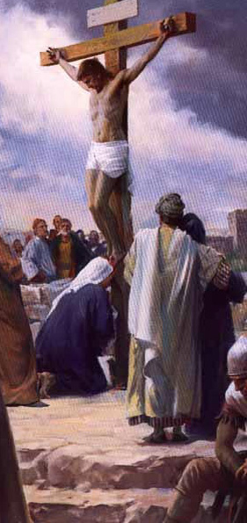
Idolatry in Our Time

Slide 15
Idolatry in Our Time
Jesus pointed to the bronze serpent
Yet that symbol itself became an idol
Can the symbol of the cross be an idol?
“flee from idolatry”

Slide 17
Jesus and the Serpent
John 3:14-16
- An image of destruction
- A manifestation in that image for life
- A act of faith in that manifestation
Notes:
Joh 3:14 "And as Moses lifted up the serpent in the wilderness, even so must the Son of Man be lifted up, 15 "that whoever believes in Him should not perish but have eternal life. 16 "For God so loved the world that He gave His only begotten Son, that whoever believes in Him should not perish but have everlasting life. 17 "For God did not send His Son into the world to condemn the world, but that the world through Him might be saved.

Slide 18
To Find Healing Today
Hearing and Believing – Romans 10:17
Confessing Jesus as Lord – Romans 10:9
Repentance from sin – Romans 2:4
Baptism in water into Christ – Romans 6:3
Continuing in Christ – Romans 11:22

